Slide 1



Applied Data Analysis (CS401)
Lecture 5
Regression for disentangling data
18 Oct 2023
Robert West
Notes:
2020: Length is good: 2-3 minutes over
2021: Finished 5 min early (whaaat?!), with 15 min break
2022: Finished exactly on time (whaaaaaaat?!), with a 13-min break + 5 min for indicative feedback
2023: Finished exactly on time (whaaaaaaaaaaaaat?!), with a 10-min break (no extra time for indicative feedback, but could have gone faster, esp. towards end)

Slide 2
Announcements
Homework H1 due end of next week
Due Fri 27 Oct 23:59
Project milestone P1 feedback to be released next week
Final exam has been scheduled: Tue 16 Jan 2024, 15:15–18:15
Friday’s lab session:
Quiz 4
Exercise on regression analysis (in BCH 2201)
Homework office hours (on Zoom, in parallel to exercise)
Indicative course feedback is being collected (until Sun 22 Oct)
Notes:
Lab sessions only in BCH2201 from now on; no more CE1106

Slide 3
Feedback
Give us feedback on this lecture here: https://go.epfl.ch/ada2023-lec5-feedback
What did you (not) like about this lecture?
What was (not) well explained?
On what would you like more (fewer) details?
…

Slide 4

Course eval (“indicative feedback”) open until 22 Oct Go to https://isa.epfl.ch now!

Slide 5

Linear
regression
Notes:
A versatile tool, many purposes
If data analysis was a car, then you could say that lin reg is the engine

Slide 6
Credits
Much of the material in this lecture is based on Andrew Gelman and Jennifer Hill’s great book “Data Analysis Using Regression and Multilevel/Hierarchical Models”, available for free here
For a neat and gentle written intro to linear regression, especially check out chapters 3 and 4

Slide 7


What you should already know about linear regression
POLLING TIME
“How familiar are you with linear regression?”
Scan QR code or go to https://web.speakup.info/room/join/66626
Notes:
How familiar are you with linear regression?
(A) I’m familiar with the math of linear regression.
(B) I’ve used linear regression in machine learning for making predictions.
(C) I’ve used linear regression for descriptive data analysis.
(D) I’ve used linear regression for causal analysis.
(E) I’ve heard of linear regression, but don’t know what it is.
(F) I’ve never heard of linear regression.

Slide 8
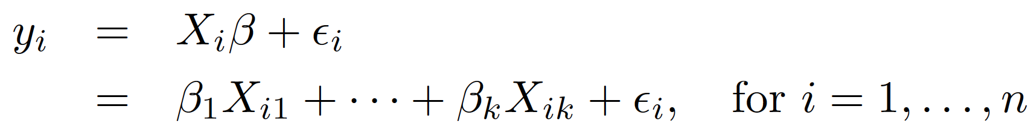
Linear regression as you know it
Given: n data points (X_{i}, y_{i}), where X_{i} is k-dimensional vector of predictors (a.k.a. features) of i-th data point, and y_{i} is scalar outcome
Goal: find the optimal coefficient vector 𝛽 = (𝛽₁, …, 𝛽_{k}) for approximating the y_{i}’s as a linear function of the X_{i}’s: where 𝜖_{i} are error terms that should be as small as possible
X_{i1} usually the constant 1 (by def) ⇒ 𝛽₁ a constant intercept
Scalar product (a.k.a. dot product) of 2 vectors

Slide 9
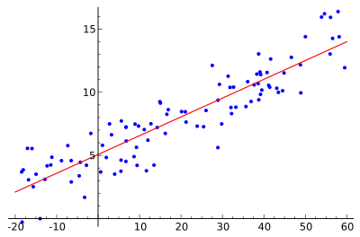
Example with one predictor
y ≈ 𝛽₁ + 𝛽₂X
y
𝛽₂: slope
𝛽₁: intercept
X
‹#›
Notes:
w/ one predictor, (X, y) is a 2-d dataset, which can be nicely visualized as a scatterplot
Linear function of one predictor describes a line
So our goal: fit red line through blue point cloud
Recall: first “feature” is a constant = 1 by convention
(interpretation of parameters)

Slide 10
Linear regression as you know it
Given: n data points (X_{i}, y_{i}), where X_{i} is k-dimensional vector of predictors (a.k.a. features), and y_{i} is scalar outcome, of i-th data point
Goal: find the optimal coefficient vector 𝛽 = (𝛽₁, …, 𝛽_{k}) for approximating the y’s as a linear function of the X’s: where 𝜖_{i} are error terms that should be as small as possible
X_{i1} usually the constant 1 → 𝛽₁ a constant intercept
?

Slide 11
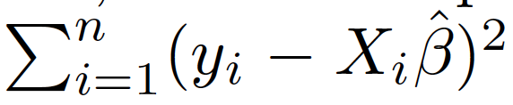
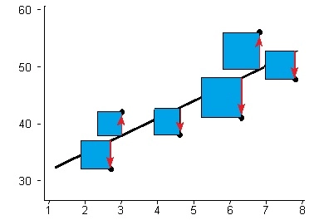
Optimality criterion: least squares
Intuitively, want errors 𝜖_{i} to be as small as possible
Technically, want sum of squared errors as small as possible ⇔ find such that we minimize
Notes:
Why squares? (1) theoretical reasons (skipped here) (2) pragmatic reason: all errors become positive (want overestimation to count as much as underestimation)

Slide 12
Use cases of regression
Prediction: use fitted model to estimate outcome y for a new X not seen during model fitting (if you’ve seen regression before, then probably in the context of prediction)
Descriptive data analysis: compare average outcomes across subgroups of data (today!)
Causal modeling: understand how outcome y changes when you manipulate predictors X (next lecture is about causality, although not primarily using regression)
Notes:
…
Causal modeling goes beyond predictive modeling: prediction doesn’t care about causality

Slide 13
Regression as comparison of average outcomes

Slide 14
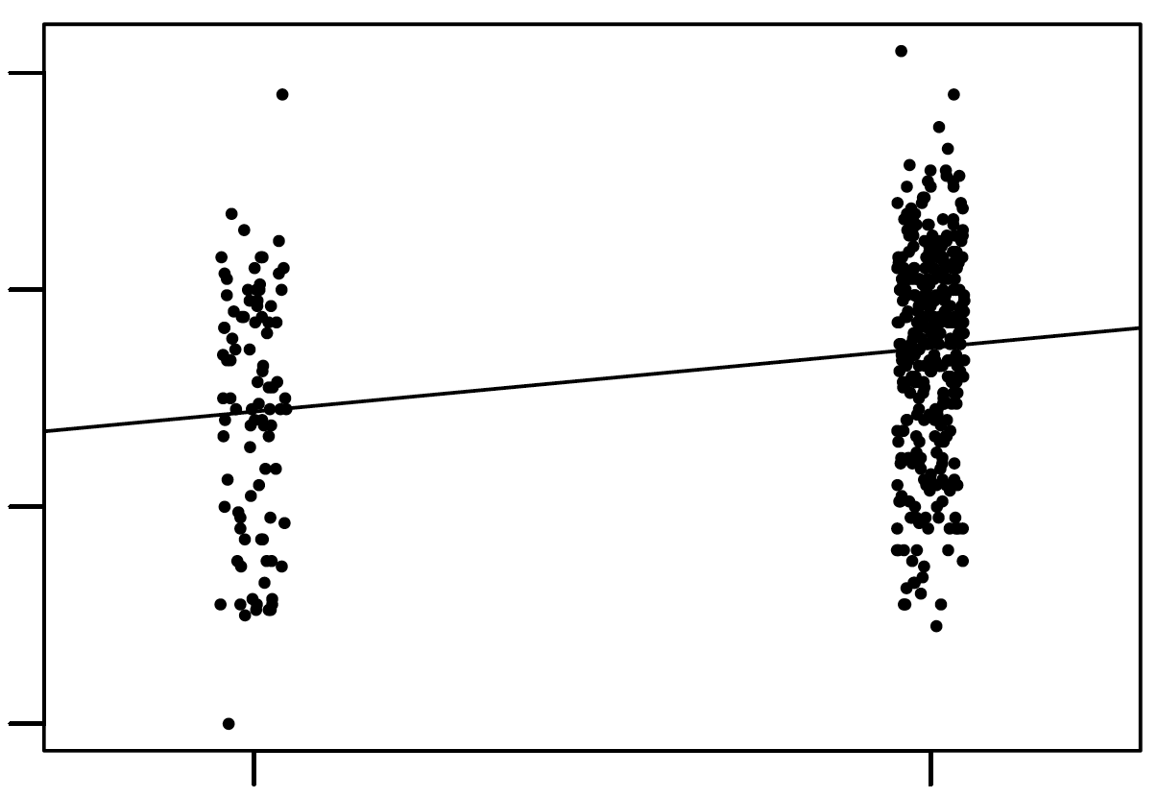
Example with one binary predictor X_{i}
No
Yes
X_{i} = mom_hs = “Did mother finish high school?” ∈ {0, 1}
y_{i} = kid_score = child’s score on cognitive test ∈ [0, 140]
y_{i} = 𝛽₁ + 𝛽₂X_{i} + 𝜖_{i .}
kid_score = 78 + 12 · mom_hs + error
kid_score
20 60 100 140
mean kid_score for moms who finished high school: 78 + 12 = 90
mean kid_score for moms who didn’t finish high school: 78
0
1
mom_hs
Notes:
(Explain plot)
All x-values are 0 or 1; in plot they are jittered horizontally in order to make the individual points better visible
Best possible line to fit the data: intercept 78, slope 12
i.e., model predicts 78 for … and 78+12=90 for …
Key insight: It turns out that the values predicted by the linear model capture the means of the 2 subgroups of mothers.
Why? Given a set of values (e.g., the y values for X=0, i.e., the left point cloud), the mean of those values is the point that minimizes the sum of squared distances from all values
which is precisely what the least-squares model predicts
Let me recap this important fact on a separate slide (p.t.o.)

Slide 15
One binary predictor X_{i}: Interpretation of fitted parameters 𝛽
y_{i} = 𝛽₁ + 𝛽₂X_{i} + 𝜖_{i .}
Intercept 𝛽₁: mean outcome for data points i with X_{i} = 0
Slope 𝛽₂: difference in mean outcomes between data points with X_{i} = 1 and data points with X_{i} = 0
Reason: means minimize least-squares criterion: ∑^{n}_{i=1} (y_{i} – m)² is minimized w.r.t. m when –2 ∑^{n}_{i=1} (y_{i} – m) = 0, i.e., when m = (1/n) ∑^{n}_{i=1} y_{i}
‹#›
Notes:
…
So what’s the mean outcome of data points with X_i=1? → \beta_1 + \beta+2
(Bonus: same derivation, but with |y_i - m| instead of (y_i - m)^2 tells you that sum of absolute errors is minimized when m is median!)

Slide 16

One binary predictor X_{i}: Interpretation of fitted parameters 𝛽
y_{i} = 𝛽₁ + 𝛽₂X_{i} + 𝜖_{i .}
Intercept 𝛽₁: mean outcome for data points i with X_{i} = 0
Slope 𝛽₂: difference in mean outcomes between data points with X_{i} = 1 and data points with X_{i} = 0
Reason: means minimize least-squares criterion: ∑^{n}_{i=1} (y_{i} – m)² is minimized w.r.t. m when –2 ∑^{n}_{i=1} (y_{i} – m) = 0, i.e., when m = (1/n) ∑^{n}_{i=1} y_{i}
So why not just compute the two means separately and then compare them?
‹#›
What a mean monkey!
Notes:
Here enters a protagonist of today’s lecture: the mean monkey, who asks mean questions about means
…
We’ll come back to the mean monkey’s question in a few slides from now

Slide 17
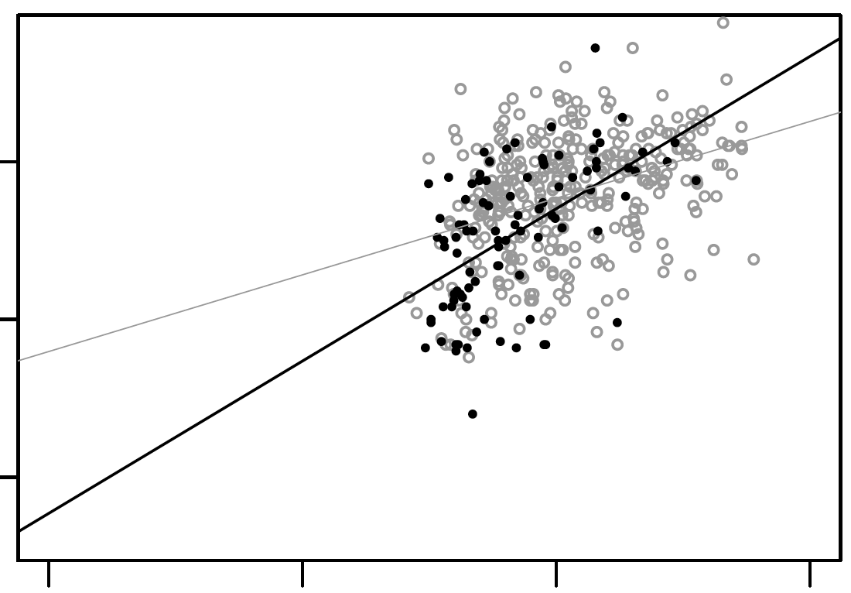
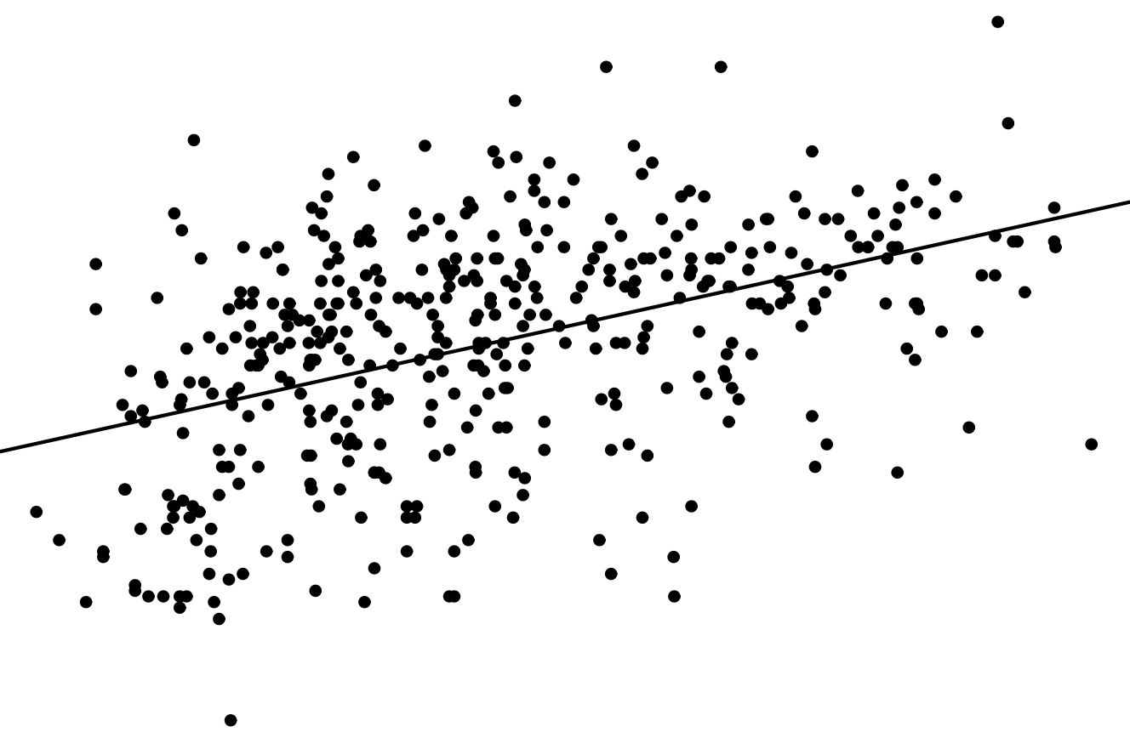

Example with one continuous predictor X_{i}
X_{i} = mom_iq = mother’s IQ score ∈ [70, 140]
y_{i} = kid_score = child’s score on cognitive test ∈ [0, 140]
y_{i} = 𝛽₁ + 𝛽₂X_{i} + 𝜖_{i .}
kid_score = 26 + 0.6 · mom_iq + error
estimated (hypothetical) mean kid_score for moms with IQ = 0: 26
kid_score
0 50 100
estimated mean kid_score for moms with IQ = 100: 26 + 0.6 · 100 = 86
0 50 100 150
mom_iq
Notes:
Previous example: binary predictor, continuous outcome
But same logic applies to continuous, rather than binary, predictors:
Model prediction for a given X is estimated mean outcome for points with the given X
…
Note that the intercept doesn’t really make sense: it’s not speaking to a situation that ever arises (no data at that X position)
We’ll see later how to address this

Slide 18
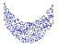
One continuous predictor X_{i}: Interpretation of fitted parameters 𝛽
y_{i} = 𝛽₁ + 𝛽₂X_{i} + 𝜖_{i .}
Intercept 𝛽₁: estimated mean outcome for data points i with X_{i} = 0
Slope 𝛽₂: difference in estimated mean outcomes between data points whose X_{i}’s differ by 1
Why “estimated”? → e.g.,
NB: for binary predictor, we got “exact” instead of “estimated”
‹#›
Notes:
…
Example: data not well described by a line; regression line in red; actual mean for X=0 is smaller than regression intercept
Problem: process that generated the model isn’t well described by a linear model (“round peg for square hole”)
Cf. “assumptions” slide later on

Slide 19
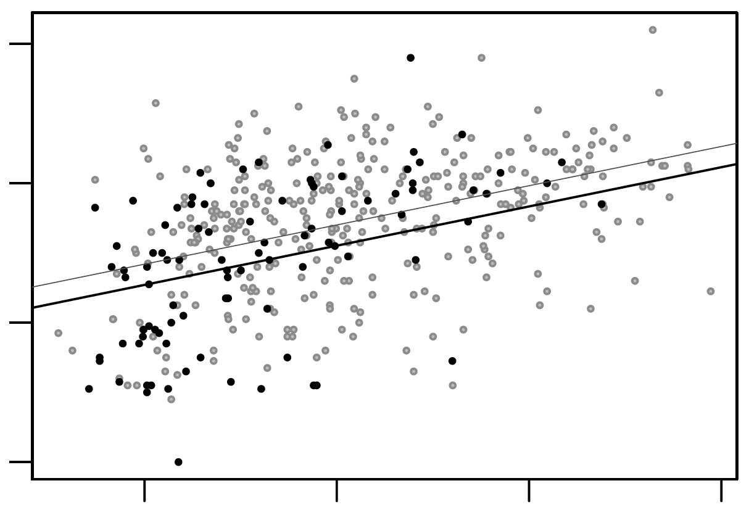
Example with multiple predictors
(X_{i1} = 1 = constant)
X_{i2} = mom_hs = “Did mother finish high school?” ∈ {0, 1}
X_{i3} = mom_iq = mother’s IQ score ∈ [70, 140]
y_{i} = kid_score = child’s score on cognitive test ∈ [0, 140]
y_{i} = 𝛽₁ + 𝛽₂X_{i2} + 𝛽₃X_{i3} + 𝜖_{i .}
kid_score = 26 + 6 · mom_hs + 0.6 · mom_iq + error
No
Yes
‹#›
Notes:
Putting the 2 previous examples together: use both predictors in a single regression
(explanation of plot: p.t.o.)

Slide 20
Example with multiple predictors
kid_score = 26 + 6 · mom_hs + 0.6 · mom_iq + error
kids of moms who finished high school:
intercept = 26 + 6 = 32
slope = 0.6
kid_score
20 60 100 140
kids of moms who didn’t finish high school:
intercept = 26
slope = 0.6
80 100 120 140
mom_iq
‹#›
Notes:
Point color encodes binary mom_hs feature (1 = gray, 0 = black)
Lines are best fits to respective subset of points (thin: gray, thick: black)
Different intercepts, same slope
…
Zoomed into x range where data lies
→ intercepts can’t be explicitly read off the plot
Intercepts again don’t have meaningful interpretation, since IQ=0 is not realistic

Slide 21
Example with interaction of predictors
No
Yes
X_{i2} = mom_hs = “Did mother finish high school?” ∈ {0, 1}
X_{i3} = mom_iq = mother’s IQ score ∈ [70, 140]
y_{i} = kid_score = child’s score on cognitive test ∈ [0, 140]
y_{i} = 𝛽₁ + 𝛽₂X_{i2} + 𝛽₃X_{i3} + 𝛽₄X_{i2}X_{i3} + 𝜖_{i .}
kid_score = −11 + 51 · mom_hs + 1.1 · mom_iq − 0.5 · mom_hs · mom_iq + error
‹#›
Notes:
Input variables same as before, but now adding a new predictor derived from them

Slide 22
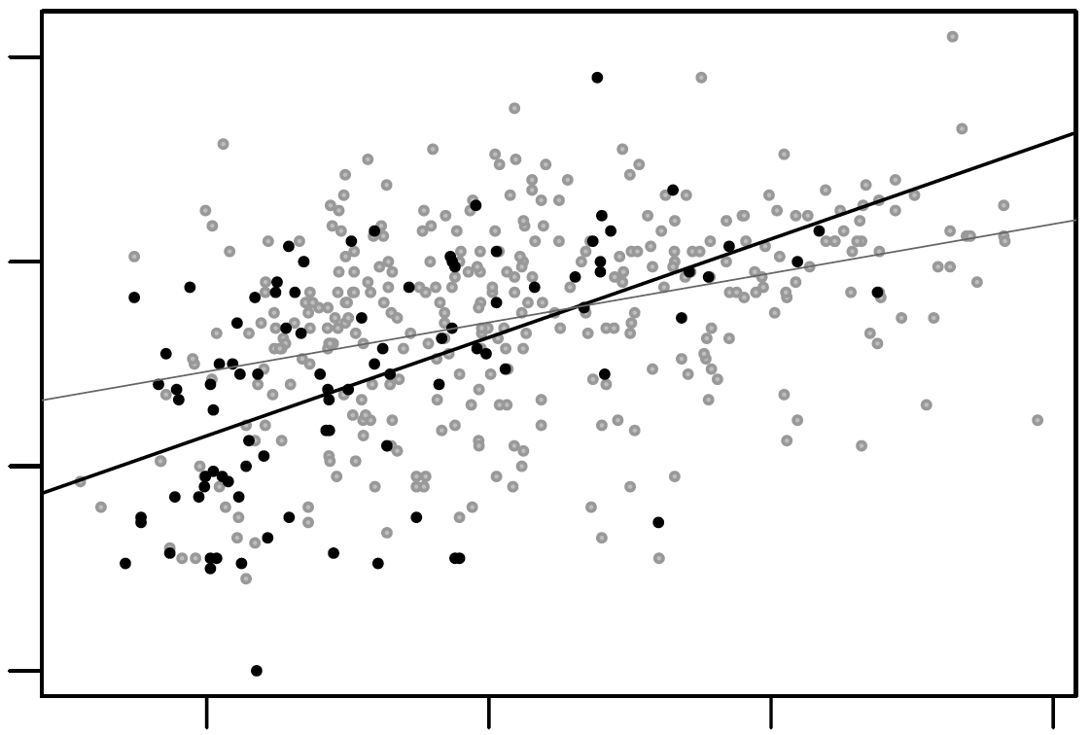
Example with interaction of predictors
kid_score = −11 + 51 · mom_hs + 1.1 · mom_iq − 0.5 · mom_hs · mom_iq + error
kids of moms who didn’t finish high school:
intercept = −11
slope = 1.1
kid_score
kids of moms who finished high school:
intercept = −11 + 51 = 40
slope = 1.1 − 0.5 = 0.6
20 60 100 140
80 100 120 140
mom_iq
‹#›
Notes:
Here the interaction term allows us to fit different slopes to the 2 subgroups of moms
Whereas non-interacted model had only different intercepts, but same slope
Finished HS → higher avg, lower slope (less dependence on mom’s IQ)
Non-interpretability of intercept here particularly striking: -11 makes no sense, considering that real scores are non-negative!

Slide 23
So why not just compute the two means separately and then compare them?
‹#›
Notes:
(I have this nagging feeling in the back of my mind... wasn’t there something? -- [CLICK] Ah yes, the mean monkey’s mean question about means!)

Slide 24
So why not just compute the two means separately and then compare them?
Mom drives Mercedes
Mom doesn’t drive Mercedes
Mom drives Mercedes
Mom doesn’t drive Mercedes
avg kid_score 90 | avg kid_score 90
avg kid_score 78 | avg kid_score 78
990 women | 10 women
10 women | 990 women
Mom finished high school
Mom finished high school
Mom didn’t finish high school
Mom didn’t finish high school
‹#›
Notes:
To answer the mean monkey’s Q, let’s look at regression w/ 2 input vars
To make it simpler: consider 2 binary vars (rather than 1 binary, 1 continuous, as before and as shown in plot)
2 binary variables → 4 combinations
Table on right: number of women for each combo

Slide 25
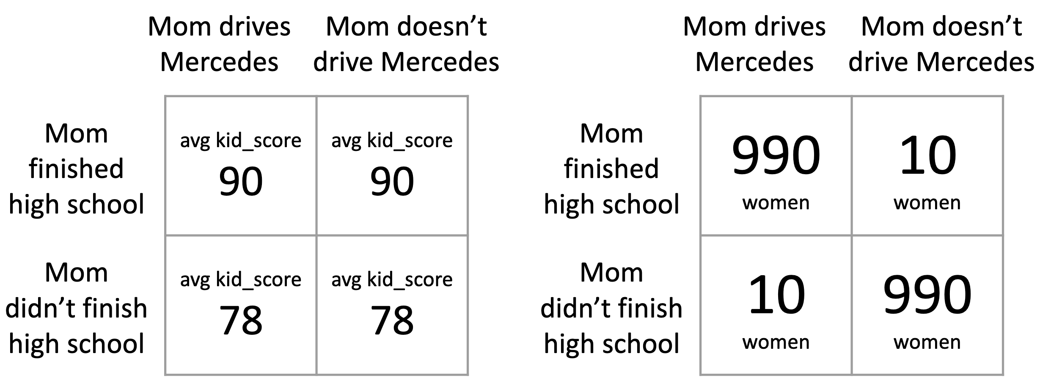
THINK FOR A MINUTE:
What is the mean outcome for Mercedes-driving moms vs. for non-Mercedes-driving moms? Compare the two means! What does the comparison tell you about the link between Mercedes-driving and kid_score?
(Feel free to discuss with your neighbor.)
Notes:
Then: share

Slide 26
Mean kid_score for Mercedes drivers: 0.99 · 90 + 0.01 · 78 ≈ 90
Mean kid_score for non-Mercedes drivers: 0.01 · 90 + 0.99 · 78 ≈ 78
But really driving Mercedes makes no difference (for fixed high-school predictor)!
Root of evil: correlation between finishing high school and driving Mercedes
Regression to the rescue: kid_score = 78 + 12 · mom_hs + 0 · mercedes + error
Mercedes
No Mercedes
Aha!
Mercedes
No Mercedes
mean kid_score 90 | mean kid_score 90
mean kid_score 78 | mean kid_score 78
990 women | 10 women
10 women | 990 women
Mom finished high school
Mom finished high school
Mom didn’t finish high school
Mom didn’t finish high school
‹#›
Notes:
For fixed HS (row): Mercedes (col) makes no difference in either case
For fixed Mercedes (col): HS (row) makes a difference of 12 in both cases
…
This advantage of regression modeling is why today’s is called “Regression for disentangling data” – data that may be entangled via correlations b/w vars

Slide 27
Course eval (“indicative feedback”) open until 22 Oct Go to https://isa.epfl.ch now!
Notes:
2023: Break here, after 45 minutes

Slide 28
Quantifying uncertainty

Slide 29
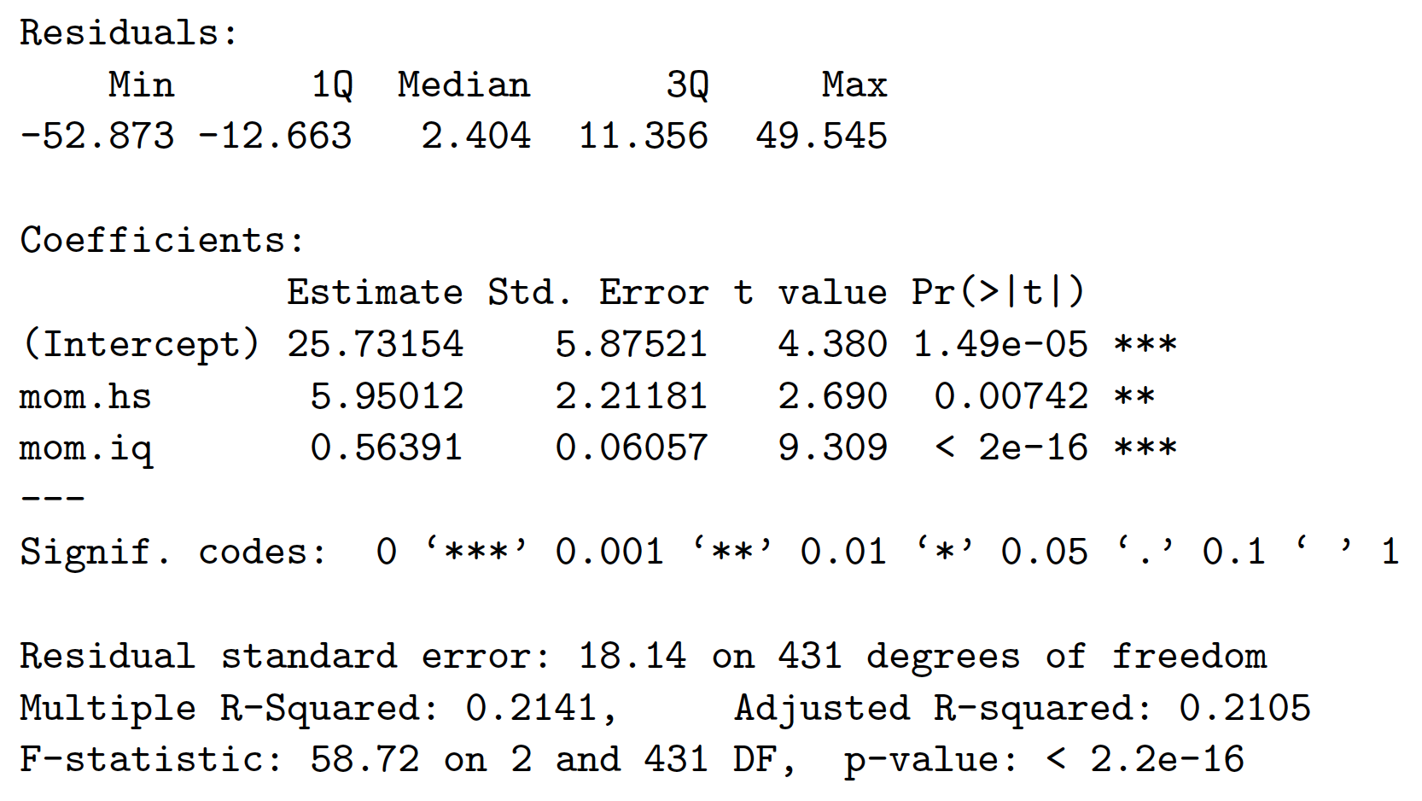
Quantifying uncertainty
Statistical software gives you more than just coefficients 𝛽:
p-value: probability of estimating such an extreme coefficient if the true coefficient were zero (= null hypothesis)
Aha!
‹#›
Notes:
You get p-values for free!!!

Slide 30
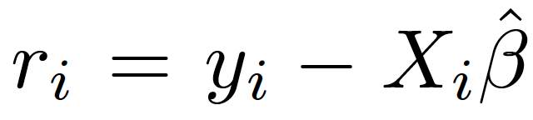
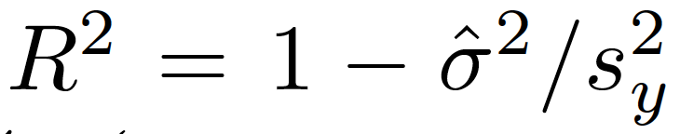
Residuals and R²
Residual for data point i: estimation error on data point i:
Mean of residuals = 0 (total overestimation = total underestimation)
Variance of residuals = avg squared distance of predicted value from observed value = “unexplained variance”
Fraction of variance explained by the model:
Variance of outcomes y
‹#›
Notes:
“Mean = 0” follows from least-squares loss function:
Assume \beta minimizes \sum_i r_i^2 = \sum_i (y_i - X_i \beta)^2 (that’s what linear regression does)
Consider \sum_i (r_i - m)^2, which is minimized w.r.t. m when m = mean(r_i) (see slide 15 for proof)
Assume m != 0. Set intercept \beta_1’ = \beta_1 + m, and the resulting loss \sum_i r_i^2 (with \beta_1’ instead of \beta_1) would be even smaller than w/ the original \beta_1, a contradiction to the assumption that \beta is optimal. Hence, the assumption “m != 0” can’t be true, so m = mean(r_i) = 0, q.e.d.
(use plot to illustrate unexplained variance and variance of y; after you pull regression line down so it becomes horizontal, then Var(y) = unexplained variance)
If observed data lies on a line, then unexplained variance = 0

Slide 31
Residuals and R²
Residual for data point i: estimation error on data point i:
Mean of residuals = 0 (total overestimation = total underestimation)
Variance of residuals = avg squared distance of predicted value from observed value = “unexplained variance”
Fraction of variance explained by the model:
Aha!
Variance of outcomes y
‹#›

Slide 32
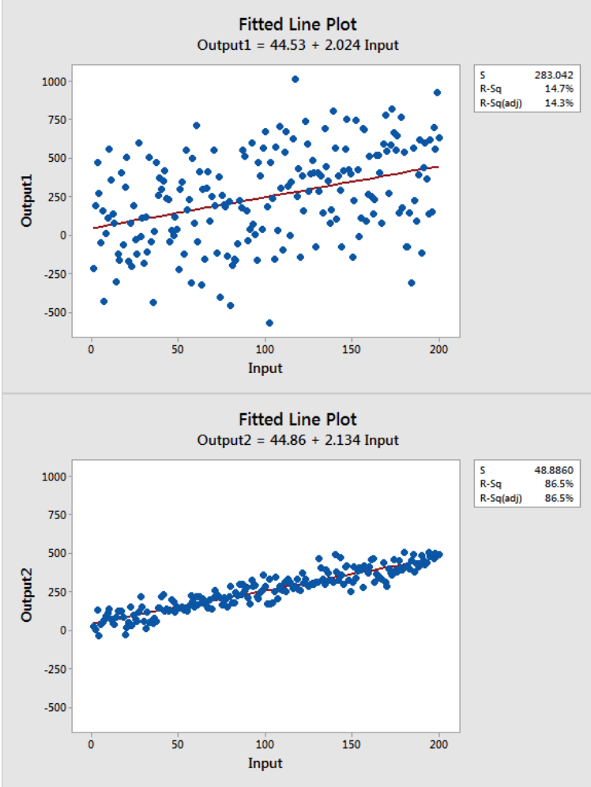
Coefficient of determination: R²
R² = 0.147
R² = 0.865
‹#›
Notes:
Similar models, vastly different goodness of fit
For linear regression with one predictor: R^2 = squared Pearson corr coeff

Slide 33
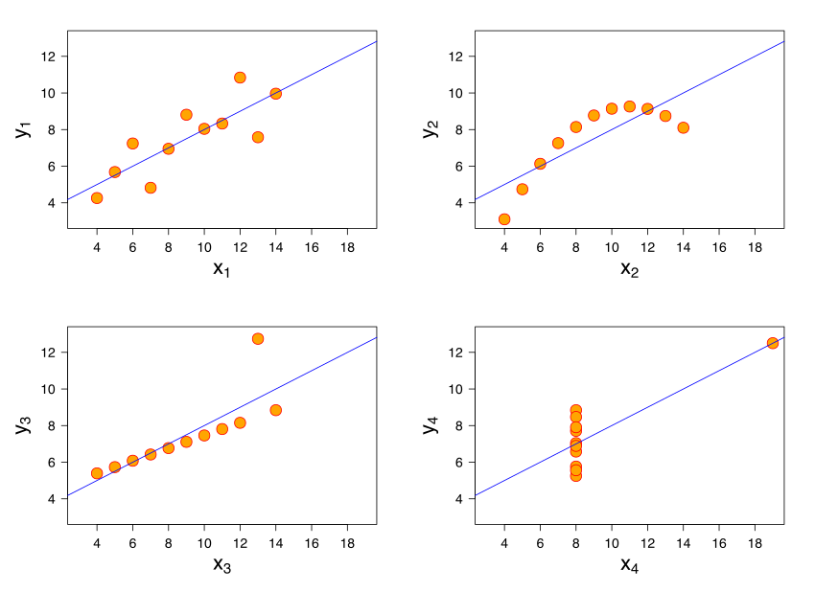
Coefficient of determination: R²
‹#›
Notes:
“Anscombe’s quartet” (see lec. 4)

Slide 34
Coefficient of determination: R²
R² = 0.67 everywhere!
‹#›
Notes:
Cautionary note: careful when interpreting R2; also visualize data (if dimensionality allows it)

Slide 35
Assumptions made in regression modeling
Notes:
What I’ve shown you so far about lin reg, is pretty neat, isn’t it?
Would be too good to be true, if there weren’t some “but”s
Not a panacea, but comes w/ assumptions

Slide 36
Assumptions for regression modeling
Validity:
Outcome measure should accurately reflect the phenomenon of interest
Model should include all relevant predictors
Model should generalize to cases to which it will be applied
‹#›
Notes:
E.g., do children’s test scores actually capture children’s intelligence?
Maybe the hardest task! Regression computations are boring and tedious, can be done by a dumb computer. Specifying the model (still) requires a smart human scientist
Model fitted on data from Swaziland might not be useful for Switzerland

Slide 37

Assumptions for regression modeling (2)
Linearity:
But very flexible: we require linearity in predictors (not necessarily in raw inputs); predictors can be arbitrary functions of raw inputs, e.g., - logarithms, polynomials, reciprocals, … - interactions (i.e., products) of multiple inputs - discretization of raw inputs, coded as indicator variables
‹#›
Notes:
Model must be well specified: must be expressive enough to capture the real “shape of the data”
See slide 18 for an example where this is not the case (also shown here)
Important distinction between raw inputs and predictors; raw inputs can be “reused” in multiple predictors
E.g., square allows to model U-shape (cf. pic)
Discretization allows to model arbitrary shapes (at cost of adding more predictors, and thus decreasing statistical power)
(More on later slide)

Slide 38
Assumptions for regression modeling (3)
Independence of errors: no interaction between data points
Equal variance of errors
Normality (Gaussianity) of errors
less important in practice
‹#›

Slide 39
Transformations of predictors and outcomes

Slide 40
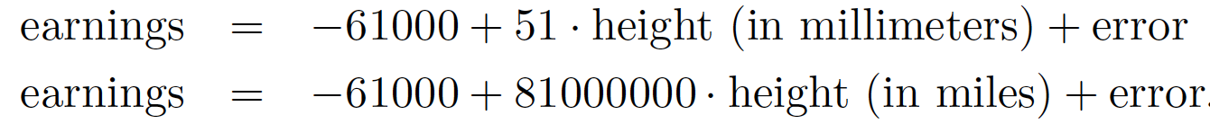
Transformations of predictors
When we apply linear transformations to predictors, the model remains “equally good”:
The fitted coefficients may change, but predicted outcomes and model fit (R²) won’t change
For instance,
‹#›
Notes:
Linear functions are closed under composition

Slide 41
Mean-centering of predictors
Compute the mean value of a predictor over all data points, and subtract it from each value of that predictor: X_{ij} ← X_{ij} − mean(X_{1j}, …, X_{nj})
⇒ the predictor X_{ij} now has mean 0
mean kid_score for moms with mean IQ: 86
(hypothetical) mean kid_score for moms with IQ = 0: 26
kid_score
0 50 100
0 50 100
0 50 100 150
-100 -50 0 50
mom_iq
‹#›
Notes:
Before, we couldn’t readily interpret the intercept -- now we can!

Slide 42
After mean-centering of predictors, …
… you have a convenient interpretation of coefficients 𝛽_{j} of main predictors (i.e., non-interaction predictors):
j = 1 (i.e., intercept):
Estimated mean outcome when each predictor has its mean value
j > 1:
Model w/o interactions: estimated mean increase in outcome y for each unit increase in X_{ij}
Model with interactions: estimated mean increase in outcome y for each unit increase in X_{ij} when each other predictor has its mean value
‹#›
Notes:
…
(because then the interaction terms = 0)

Slide 43
Standardization via z-scores
First mean-center all predictors, then divide them by their standard deviations: X_{ij} ← [X_{ij} − mean(X_{1j}, …, X_{nj})] / sd(X_{1j}, …, X_{nj})
Resulting values are called “z-scores”
All predictors now have the same units: distance (in terms of standard deviations) from the mean
This lets us compare coefficients for predictors with previously incomparable units of measurement, e.g., IQ score vs. earnings in Swiss francs vs. height in centimeters
‹#›
Notes:
A change of 1 SD in the input translates to a change of \beta in the output
(as before, when we have interactions, this is true only for the case when all other predictors take on their mean values)

Slide 44
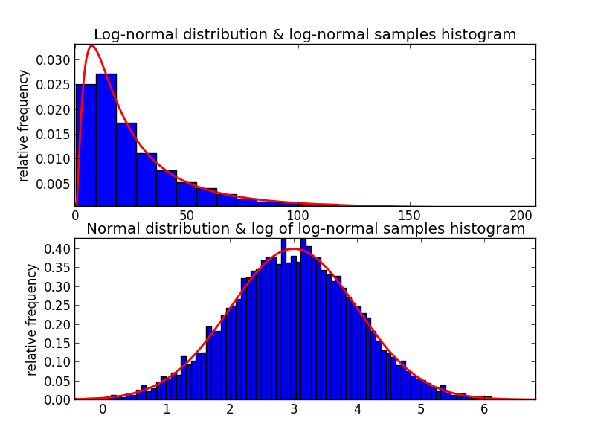
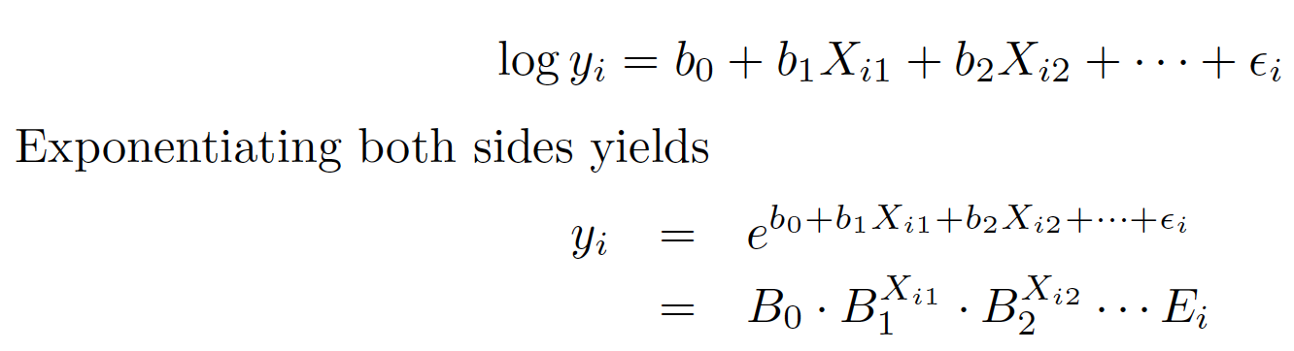
Logarithmic outcomes
Practical: makes sense if the outcome y follows a heavy-tailed distribution
Only works for non-negative outcomes
Theoretical: turns an additive model into a multiplicative model:
‹#›
Notes:
Theme of this class: regression in order to compare means
But remember: (arithmetic) means are meaningless for heavy-tailed data (e.g., power laws)
As before: logs are your friends (a common theme in this class)
…
Another way of seeing it: logs let you estimated geometric (rather than arithmetic) means

Slide 45
Logarithmic outcomes: Interpreting coefficients
An additive increase of 1 in predictor X_{·1} is associated with a multiplicative increase of B₁ := exp(b₁) in the outcome
If b₁ ≈ 0, we can immediately interpret b₁ (without needing to exponentiate it first to get B₁!) as the relative increase in outcomes, since exp(b₁) ≈ 1 + b₁
E.g., b₁ = 0.05 ⇒ B₁ = exp(b₁) ≈ 1.05 ⇒ “+1 in predictor X_{·1}” is associated with “+5% in outcome”
‹#›
Notes:
That’s why you should take natural logs, rather than, say, binary or decimal logs!
(Bonus: if u want to interpret the coefs this way close to an arbitrary constant != 0: here’s a simple trick)
Can also make predictors logarithmic, or both predictors and outcome
Food for thought: think about interpretation! (also see appendix slide)

Slide 46
Going beyond linear regression for comparing means

Slide 47
Beyond linear regression: generalized linear models
Logistic regression: binary outcomes
Poisson regression: non-negative integer outcomes (e.g., counts)
‹#›

Slide 48
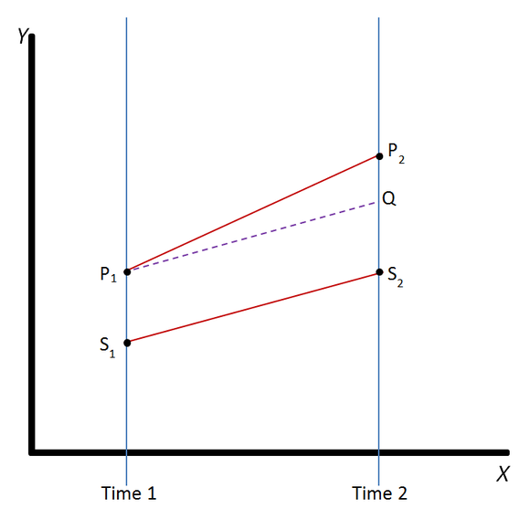
Beyond comparing means; or, A taste of causality: “Difference in differences”
Two groups: P, S
At time 2, group P receives a treatment, group S doesn’t
Question: Did the treatment have an effect? If so, how large was it?
P and S don’t start out the same at time 1
There is a temporal “baseline effect” even w/o treatment
Notes:
https://en.wikipedia.org/wiki/Difference_in_differences

Slide 49
Beyond comparing means; or, A taste of causality: “Difference in differences” (2)
Elegant linear model with binary predictors: y_{it} = a + b · treated_{i} + c · time2_{t} + d · (treated_{i} · time2_{t}) + error_{i}
d = treatment effect
All of this with one single regression!
You get quantification of uncertainty (significance) for free!
d
b
c
a
Notes:
https://en.wikipedia.org/wiki/Difference_in_differences
y_it: outcome for data point i at time t
treated_i: was data point i treated (i.e., does it belong to group P)?
time2_t: does time t = 2?

Slide 50
Beyond comparing means; or, A taste of causality: “Difference in differences” (2)
What a treat!
Elegant linear model with binary predictors: y_{it} = a + b · treated_{i} + c · time2_{t} + d · (treated_{i} · time2_{t}) + error
d = treatment effect
All of this with one single regression!
You get quantification of uncertainty (significance) for free!
d
b
c
a
Notes:
https://en.wikipedia.org/wiki/Difference_in_differences
y_it: outcome for data point i at time t
treated_i: was data point i treated (i.e., does it belong to group P)?
time2_t: does time t = 2?

Slide 51
A bonanza of causality:
Next lecture!
$#1t!, my banana is non-linear…
Notes:
This was a taste of causality
Next lecture, we’ll go all in, and will embark on a bonanza of causality

Slide 52
Summary
Linear regression as a tool for comparing means across subgroups of data
How? Read group means off from fitted coefficients
Advantages over plain comparison of means “by hand”:
Accounting for correlations among predictors
Quantification of uncertainty (significance) “for free”
Additive vs. multiplicative model: all it takes is a log
Caveat emptor:
Model must be appropriately specified, else nonsense results → stay critical, run diagnostics (e.g., R², data viz)
‹#›

Slide 53
Course eval (“indicative feedback”) open until 22 Oct Go to https://isa.epfl.ch now!

Slide 54
Feedback
Give us feedback on this lecture here: https://go.epfl.ch/ada2023-lec5-feedback
What did you (not) like about this lecture?
What was (not) well explained?
On what would you like more (fewer) details?
…

Slide 55
Credits
Much of the material in this lecture is based on Andrew Gelman and Jennifer Hill’s great book “Data Analysis Using Regression and Multilevel/Hierarchical Models”, available for free here
For a neat and gentle written intro to linear regression, especially check out chapters 3 and 4

Slide 56
Bonus: Logarithmic outcomes and predictors
Interpretation of coefficient of logarithmic predictor:
Multiplicative increase by 1% in predictor X_{·1} is associated with a multiplicative increase by b₁% in the outcome
Why?
log(y) = a + b log(X) ⇒ y = exp(a) * X^{b}
Multiplying X by a factor c multiplies y by a factor of c^{b}
c^{b} ≈ 1 + b*(c–1) for c ≈ 1 (hint: Taylor approximation!)
Example when using c = 1.01 (i.e., increase by 1%): b = 2 ⇒ increasing X by 1% increases y by 2%
‹#›

